Slide 1
South West Area Research & Insight
Amanda Leonard
Area Manager South West
29th January, 2024

Slide 2
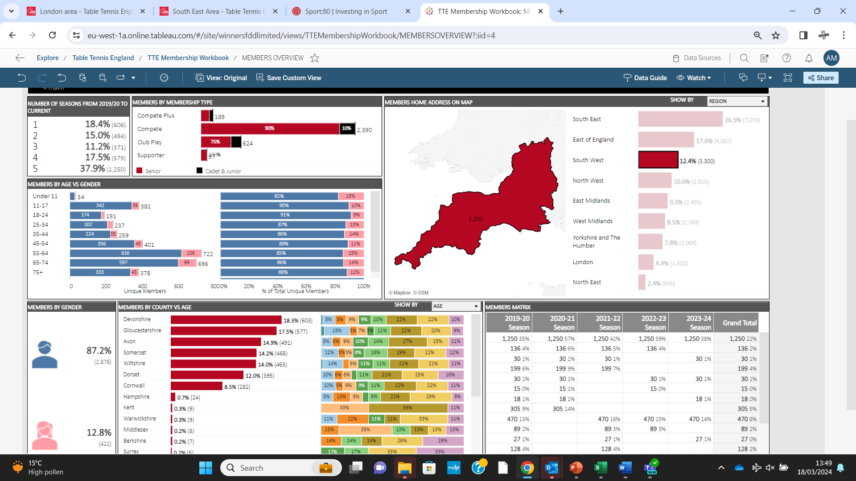

Slide 3
The Region – Focus on

Slide 4
The Region - Membership
per 100,000 population
Area Average = 56
Gloucester = 72
Somerset = 62
Wiltshire = 62
Dorset = 52
Cornwall = 49
Devon = 48
Bristol = 36

Slide 5
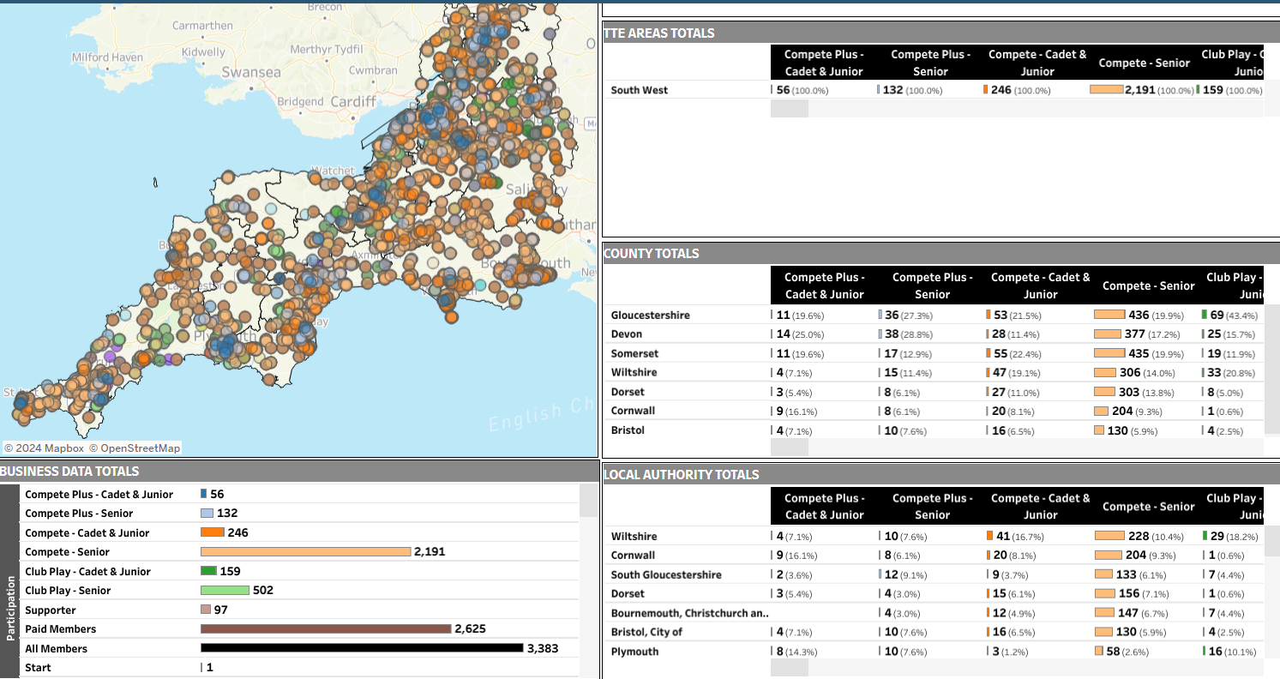
The Area – All Members

Slide 6
The Region – Participation - Junior
per 100,000 population
Area Average = 8
Gloucester = 13
Bristol = 5
(skew based on age profile?)

Slide 7
Clubs - all

Slide 8
Clubs - Premier

Slide 9
Qualified Coaches - all

Slide 10
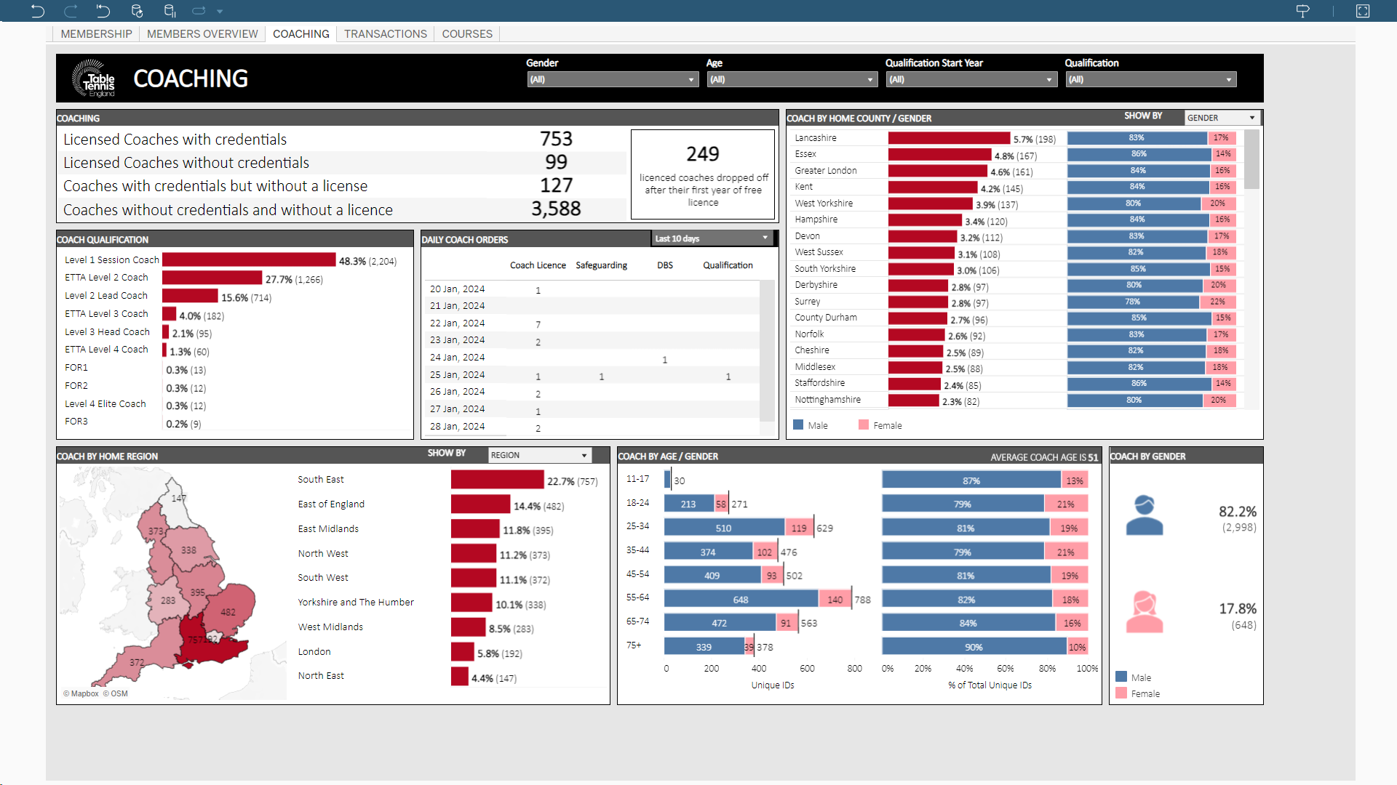
Coaching Workforce Age & Gender

Slide 11
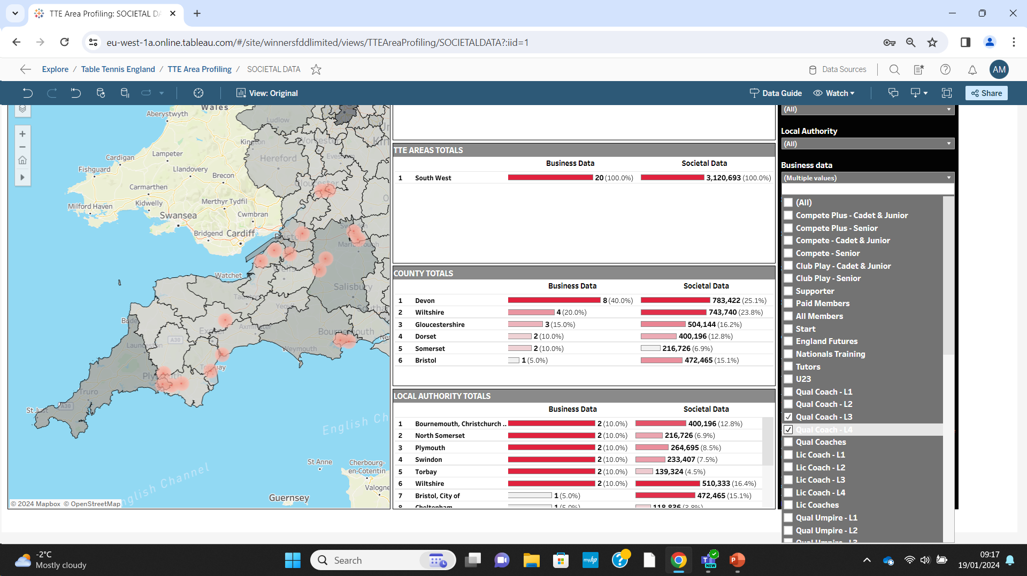
Qualified Coaches – Higher level L3, L4
2 Tutors – Gloucester & Plymouth

Slide 12
Good things happening across the South West
West Cornwall – Junior Development, Level 1 Coach & Umpire course
Joola & Plymouth Partnership – School links, Local Authority, Young Leaders, Coach & Officials Development, EDI, Talent Development (Player Development Centre)
Somerset at the beginnings of creating a County Plan
Weston TT Community working with a school to create a new centre. Successful Sport England grant and set up a charity.
Ashcott TTC Junior development, U3A link and underpins the Village Hall

Slide 13
Good things happening across the South West
Women & Girls Ambassador, coaching & Coach Educator Emma Harradine
SGS College – TT Academy, wider talent development, coach development including mentoring, young leaders
Stroud, Nailsworth, Cheltenham & Gloucester cooperative working Junior Development, Level 1 Coach course, 6 TT Kidz courses
Gloucestershire (including South Gloucestershire) data is strong
‘Greater Bristol’ Table Tennis Community servicing a wider area
Kennet Vale – Junior Development, recruiting Women retiring from other sports, A network of village halls, a new Premier Club, digital footprint
Malmesbury TTC a new club is growing

Slide 14
Good things happening across the South West
The ARC Bideford about to open a new Table Tennis facility as part Racket Sports offer
Harnham U3A are investigating social prescribing
And much more……. ?

Slide 15
Recurring Themes
Clubs with lots of coaches of all levels thrive. This spills into other areas.
Hub and spoke development examples work in rural and urban environments
The relationship with the facility can be an enabler
Integration with the Table Tennis community and other local organisations such as U3A strengthens clubs
Social media and websites are used with mixed success / understanding
Day to day activities are often self-sustaining but how to aborb the risk of setting up or growing. And how to fund widening participation. Table replacement.
And more……..

Slide 16
Recurring Themes
Junior Development can be in isolated pockets, volunteers and juniors would benefit from connecting
Club outreach work has been effective recruiting juniors such as school links. How to reach schools initially?
Coaches are seeking more ideas and resources or creating their own
Junior Competition – entry level, more accessible tournaments & festivals (less driving), friendlies, girls
Pockets of success recruiting women and girls. When it works it really works
Some great examples of people with disabilities playing and coaching (Clubs do not always advertise that they are inclusive)
People from areas of disadvantage do not join TTE or play competitively. Are they playing in informal settings?

Slide 17
Table Tennis United Goals
Connection across the Table Tennis Community
Tackling Inequalities
Growing a Grassroots Workforce
Working in Partnership
Participation with Purpose
Competition for All
World Class Environment

